Slide 1
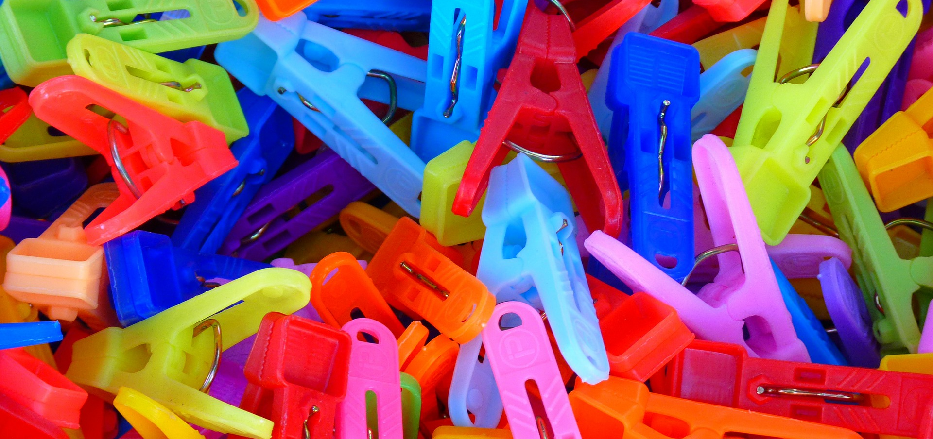
Data Engineering
Exercises

Slide 2
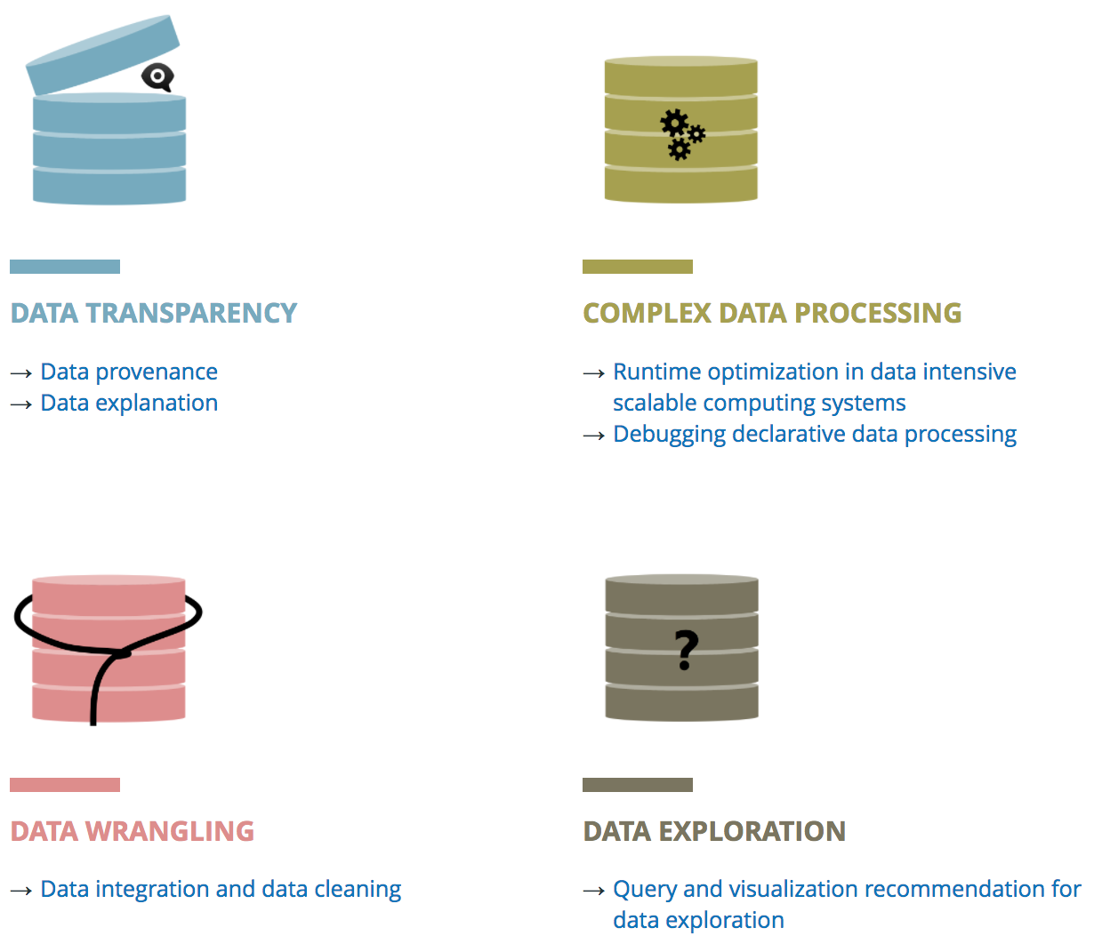
Commercials
Further information is available at: https://www.ipvs.uni-stuttgart.de/abteilungen/de/

Slide 3
Exercise Sheets
Goal: Practice exam-like exercises
4 exercise sheets in total, available in ILIAS
Solve the exercises individually (best preparation for the exam)
Solutions will be presented by students during exercise class
At the beginning of each exercise class, vote for each exercise you have worked on and are ready to present
Among those who voted for the exercise, presenters will be chosen at random
Votes will be revoked if you are selected for the presentation and have no solution
Solutions will not be graded

Slide 4
Programming Exercises
Goals:
Practical application of concepts discussed in class
There will be three programming exercises on the exercise sheets
Solve the programming exercises in groups:
Form groups of 2-3 students and send me the names of the members by email
I will then create groups in ILIAS and add the respective members
Solutions will be presented by students during exercise class:
Sketch your solution approach
Show your implementation
Present your program that produces a correct output and let it run

Slide 5
Organization
Take place alternately with the lecture on Wednesdays from 9:45 - 11:15 and 11:30 – 13:00 in room 0.463
See schedule on next slide, as some irregularities will occur
ILIAS will be used for communication of information and course material
Join the ILIAS course via CAMPUS

Slide 6
Current Schedule
Date | 9:45 – 11:15 | 11:30 – 13:00 | Handout
11.04. |  | Lecture Chapter 1: Introduction
18.04. | Practical: Introduction | Chapter 2: Data Collection | Sheet 1
25.04. | Chapter 2: Data Collection | Chapter 2: Data Collection
02.05. | Sheet 1: Data Collection | Sheet 1: Data Collection
09.05. | Sheet 1: Data Collection | Chapter 3: Data Integration | Sheet 2
16.05. | Chapter 3: Data Integration | Chapter 3: Data Integration
23.05. | Holiday
30.05. | Sheet 2: Data Integration | Sheet 2: Data Integration
06.06. | Chapter 4: Data Cleaning | Chapter 4: Data Cleaning | Sheet 3
13.06. | Sheet 2: Data Integration | Sheet 3: Data Cleaning
20.06. | Chapter 4: Data Cleaning | Chapter 4: Data Cleaning
27.06. | Sheet 3: Data Cleaning | Tane deep dive
04.07. | Chapter 5: Provenance | Chapter 5: Provenance | Sheet 4
11.07. | Sheet 4: Provenance | Sheet 4: Provenance
18.07. | Chapter 5: Provenance | Sheet 4: Provenance

Slide 7
Exam and Exam admission
Exam
Written exam
90 minutes
No supporting material allowed
Practice exam is included in the exercise sheets
Admission to the exam requires both
Voting for at least 50 % of all exercises on exercise sheets
Present and pass at least two out of three programming exercises

Slide 8
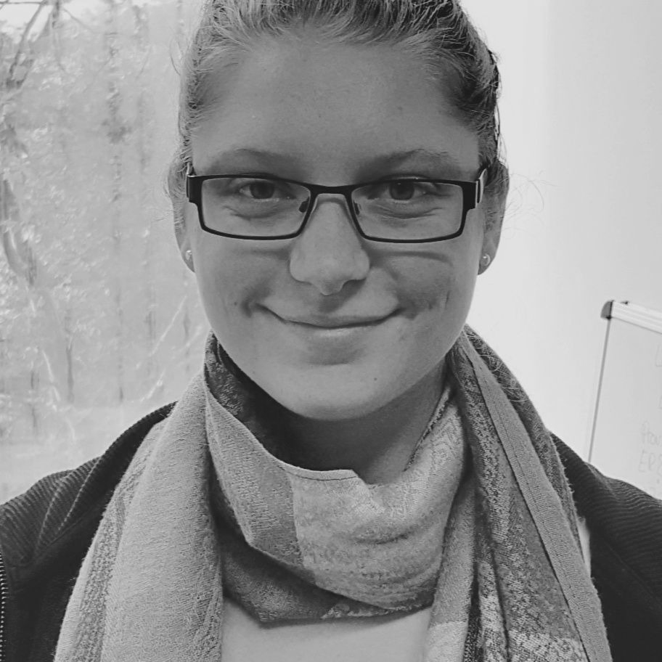
IPVS – Data Engineering
Sarah Oppold
Sarah.oppold@ipvs.uni-Stuttgart.de
88255
Office Hours: Wednesdays 13:00 – 17:00

